Slide 1
Data Science + Platform + Cloud Enablement Agile Model (Sucess is all about team)
Preetam Balijepalli
ML Solution Archictect
18/03/2020

Slide 2
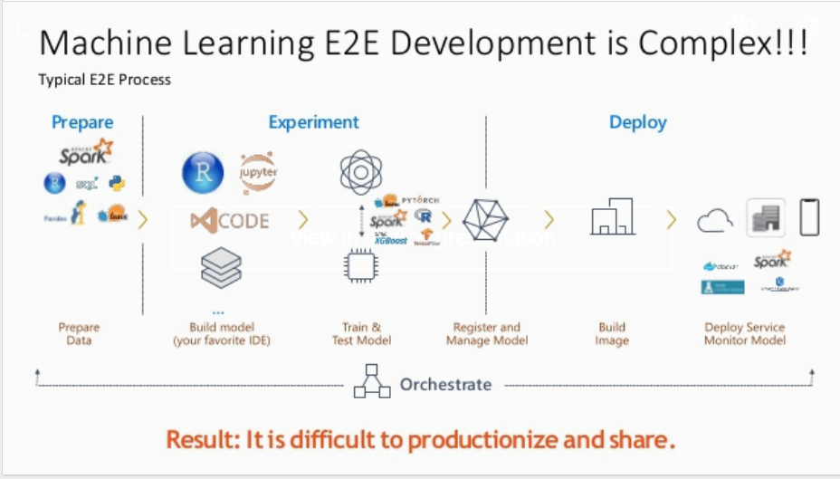


Slide 3
Journey so far
Data Scientist (DS) using Desktop
DS using Cazena Platform
DS Using ICL
DS Using DataSciece Platform
DS Using Data Science Platform + Sagemaker
June 2018
Nov 18 – June 2019
June 2019 – Aug 2019
Aug 2019
Vision for Aug 2020
More time experiment
Unable to do other tasks
Not motivated to do complex tasks
Prone to fail more often
Cannot test new services
Data on local PC
Ability to use cloud computing
Able to run task on server
Can easily used new cloud services
Data cannot be transfer on Cazena S3
Ability to use computing
Able to run task on server
Can easily install new services/Packages/tools
Data need to be transfer
Hard to find what failed
Tool versioning
Pip installation
AWS Cloud compute
Connected to Smart Mart
Not able to scale
Cannot run many high compute tasks
Very Adhoc
Container oriented
Hosting as a service
Notebook as a services
Sagemaker Algorithm
Ease of deployment
Playground for Data scientist
Crate a platform where data scientist are worried about only data Science
We need strong collaboration with Data scientist, Information security, cloud enablement and cloud factory team

Slide 4

Real Problems
What do we have?
Where should we go?
Who can help me with this?
Who is responsible for that?
Who makes decisions?
Who prioritizes ?
Where is the documentation?
Dealing with multiple teams in a product development organization is always a challenge!
Spotify engineering as an answer
https://labs.spotify.com/2014/03/27/spotify-engineering-culture-part-1/
https://labs.spotify.com/2014/09/20/spotify-engineering-culture-part-2/
We are not copying, we are tailoring it to our needs(local context) , how? …….
Back to bureaucracies and hierarchies

Slide 5
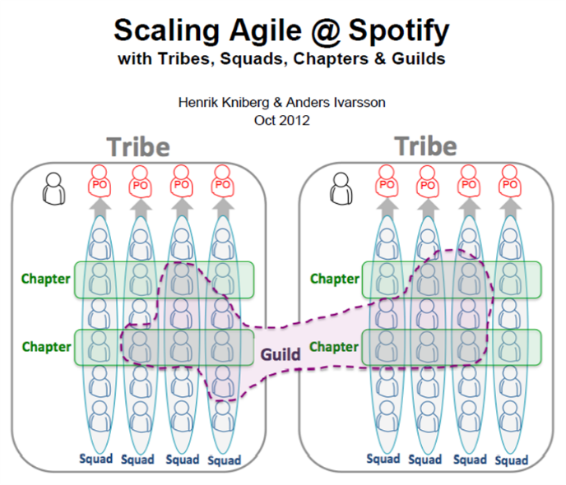
Squads
Scrum teams became “squads” like mini start-ups which is autonomous, self-organized and self-managed
consisting of 6–12 people each dedicated to work on one feature area.
you’ll have multidisciplinary teams, or squads, that comprise a mix people example from specialists, product and
commercial specialists, user-experience designers, data analysts, and IT engineers all on one “squad”
while trying to be collaborative, transparent and uses their strengths to get the best product to market in the best
amount of time
may follow KANBAN, scrum sprints, xp, or a mix and have an agile coach that help improve their way of working
while they build MVP(minimum viable product), MVP means : build it … tweak it … ship it … improve it
product owner to define the features
Tribe
considered a collection of squads within the same business area. Hence squads that work on the related feature area makes a tribe
a tribe has a tribe lead responsible for creating a productive and an innovative environment for the squads. he is part of the squad as well
consisting of 100 or more
Chapter
team members working in specialized area
a chapter consists of individuals from different squads to be grouped into one and formed within a tribe. A chapter lead is also a line manager of the chapter members and support them in their personal growth and specific challenges.
the chapter lead has weekly meetings in which all the chapter members present upcoming issues and discuss a solution.
Guild
an informal group constituted of people from different tribes who have a common interest. A person from any squad, chapter or tribe can be a part of a guild.
guild of subject matter experts(data scientists, engineers) where they can share their knowledge and help each other out, guild has a co-coordinator

Slide 6
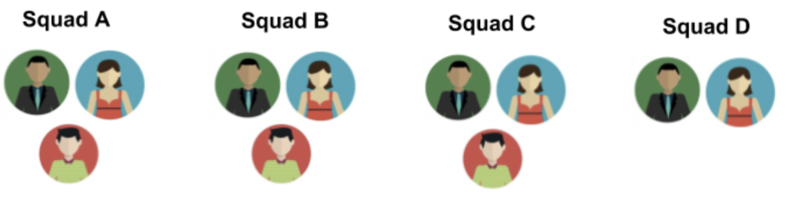
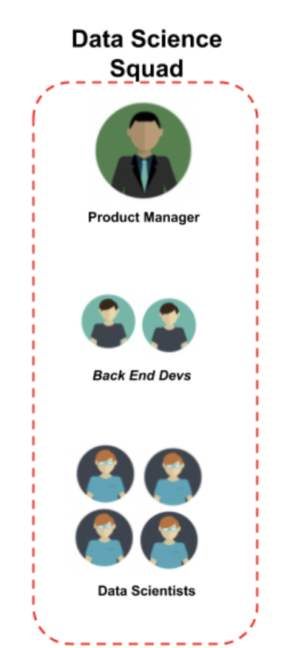
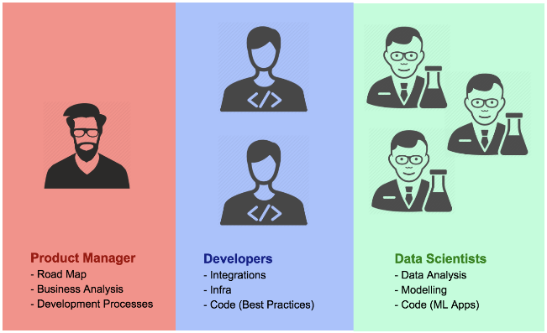
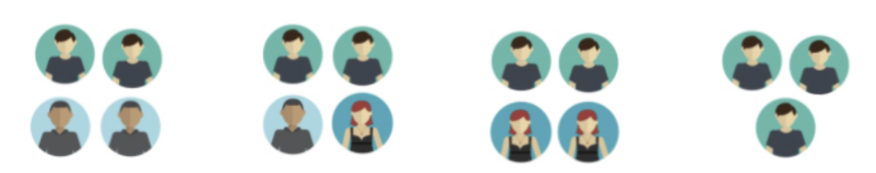

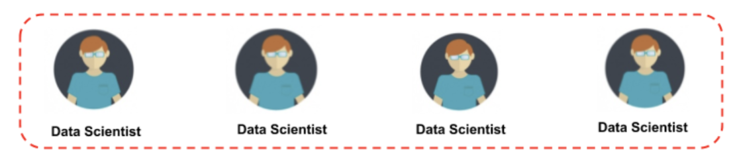
Product Owner / Business Analyst/ Designer
Product Owner / BI Analyst/ Scrum Master
Product Owner / Data Architect/ Designer
Product Owner/ Designer
Visualization Expert/ Backend End Dev
Visualization Expert/ Data Engineer
Data Engineer/ Data OPS
Mobile or Web Frontend, Backend Developer

Slide 7
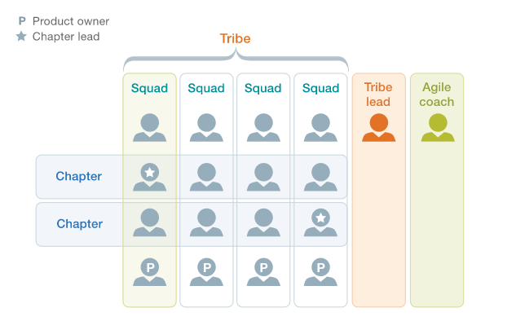
Challenges and Opportunities
Squad
Autonomy(loosely coupled with no dependencies), agility(ensures fast and better planning) and focus( clean execution and code practices)
structure will be fluid over time , hence there would cab be cross-functional alignment
Tribe
Establish dependencies between teams
Chapter
Personal development
Develop domain of excellence (e.g. GPU computing , Decision science , Statistics , Bioinformatics, OPS)
Knowledge sharing
Guild (clear existing technical debt) for current data science team members
Performance monitoring / optimization
Testing automation
Security & vulnerabilities.
Services & Architecture
Documentation & Centralized information center (Wiki)

Slide 8
Cloud Enablement Team Partnership
Road ahead with

Slide 9
Dev-OPS Team Moto
In agile, you break up development into smaller increments, adopt DevOps, promote open communication, and ultimately reconfigure your teams so they include people from different departments who are responsive to problems as they arise
—not six months down the line
Here each developer should be
Self Organized
Self Motivated
Responsible
Communicative
Senior
Perfect
Agility is about flexibility and the ability of an organization to rapidly adapt and steer itself in a new direction. It’s about minimizing handovers and bureaucracy, and empowering people.
This would
Enhanced velocity
Processes are reduced to a minimum
Addresses short term challenges
Minimized dependencies
Lack of a firm structure makes problem solving easier
Minimum control
Promotes clarity and transparency
Works best for what suits your working environment

Slide 10
Principles
embrace startup culture , efficient software releases on a much more frequent basis—every two weeks rather than having five to six “big launches”
the integration of product development and IT operations to enable us to develop innovative , new and more regulated product features
ownership is managed by an internal open-source model. Anyone is able to make changes to code, but this must be reviewed by the squad who own that component.
as long as you continue to have different departments, steering committees, project managers, and project directors, you will continue to have silos—and that hinders agility.

Slide 11
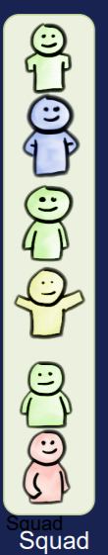
Cloud Enablement Squad Skills
IAM, Oauth , Service Catalog (Security)
EC2, EMR, Lambda
CI/CD : Nexus , Gitlab , Code Build, Code Pipeline
Monitoring: ELK, Cloud Watch and Trail , SNS (Auditability)
Automation : Cloud Formation
Network , Firewall
Route53 and API Gateway
Docker( Registry - ECR) , Kubernetes (Still to finalize)

Slide 12
Partnership Model
Steering Committee
Agile Coach
Product Sponsor
Product Owner
Squads(Team Members)
Networking Team
Networking Team
DS Platform
DS Platform
Cloud Enablement
Cloud Enablement

Slide 13
Success
FROM
TO
Adhoc setup and management of Notebook
Easy exploration in AWS notebooks
Limited and ungoverned choices of model deployment
Building around virtualization and flexibility
Competing computing resources across teams
Auto scalable model training and serving environment
Time consuming provisioning(infra)
Automated DEV-SEC- OPS practices
Lack of stage transition and reproducibility
Automated CI/CD practices

Slide 14


Thank You !

